Slide 1
Dynamical simulation of a 2-step refrigeration circle
Zoltan Mark Pinter, s172040
Supervisor: Dimitrios Papageorgiou <dimpa@elektro.dtu.dk>

Slide 2
Aim of this meeting
Describe the proceedings until now, and give you the opportunity to spot basic problems and ill-reasoned assumptions
Asking for ideas, how the simulation can be made more stable and faster, while not compromising further on fidelity
Description of a possible future problem with using explicit solvers for a system of differential algebraic equations

Slide 3
Notations
h – enthalpy
p – pressure
Q – heat flow
d or rho – density
T – temperature
Dot(m) – mass flow
V volume (constant)
Dot(V) – volume flow
M – mass (constant)
f_1 – friction coefficient
l – length of tube
d – inner diameter of tube (in the tube resistance equation)
Eta: efficiency

Slide 4
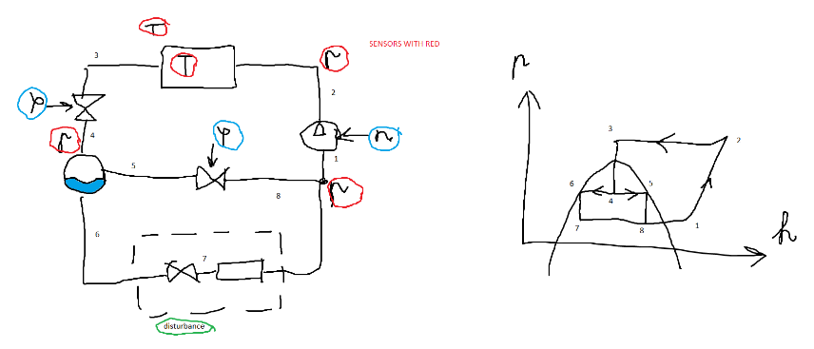
Model: Gascooler, Receiver, Evaporators, Actuators
Actuators: compressors, valves
Gascooler (condenser): detailed model, currently heat flow is considered instead of temperature-based heat transfer
Evaporators:
Cooler and freezer
Modelling with boundary conditions
Loop of algebraic equations:
Gas loop for better heat transfer (at the middle valve)
1 step version is in the figure
Supercritical operation considered

Slide 5
The course project is the side project of an industry project
Differences:
Industry project: Modelica, course project: Matlab
Matlab solver: explicit, Dymola solver: implicit-explicit solvers, with DAE solvers
Similarities:
Aim is to design a simulation that has enough fidelity to test controllers, and is quick

Slide 6
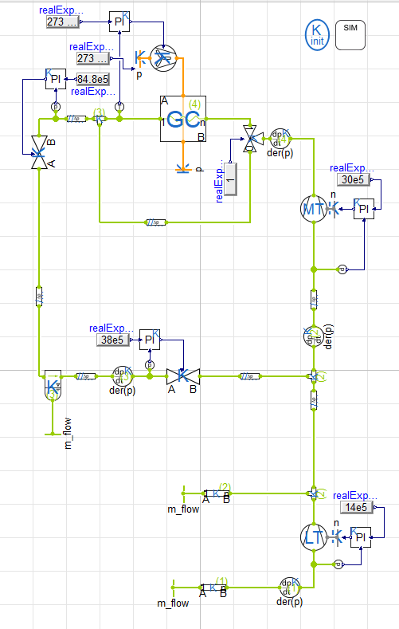
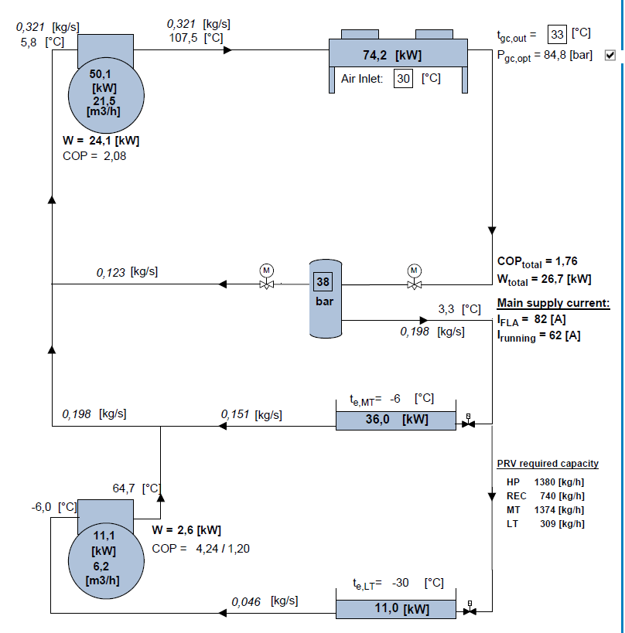
Confidential information on this slide (about long term perspective)

Slide 7
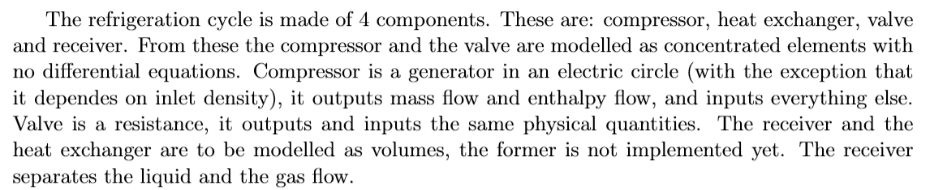
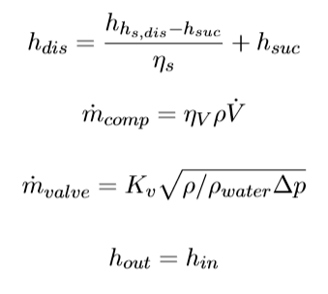
Compressor: discharge and suction sides with isentropic efficiency, mass flow and volumetric efficiency
Valve: valve coefficient, with constant rho_water, equal enthalpies

Slide 8
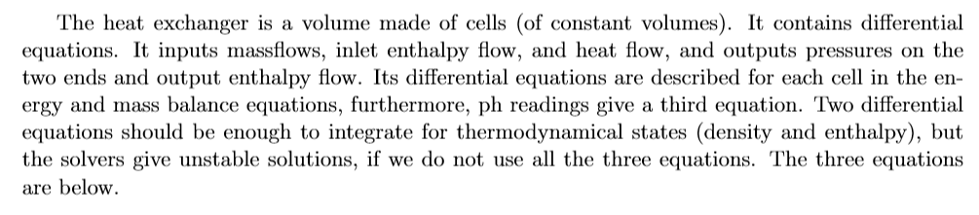
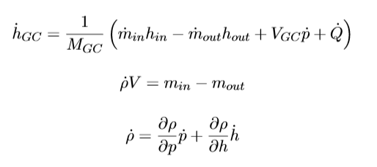
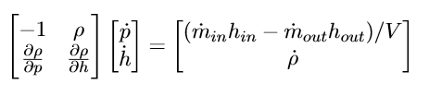
Energy balance: constant volume has zero derivative, when differentiating inner enthalpy. Dot(Q) is heat flow. Dissipation energy is neglected.
Mass balance
Partial derivatives are provided by CoolProp library (this slows the simulation significantly)
From the first and the third equation we get

Slide 9
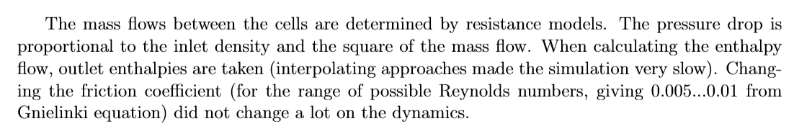

Tube resistance creates a mutual dependency between pressure and density

Slide 10
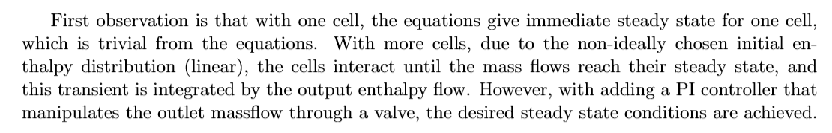
Observations during simulations
The next slides show in order the simulations for the gascooler (condenser): pressures (pascal), enthalpies (J/kg), densities (kg/m3), and sometimes mass flows (kg/s).
The figures show time evolution (unit: second)

Slide 11
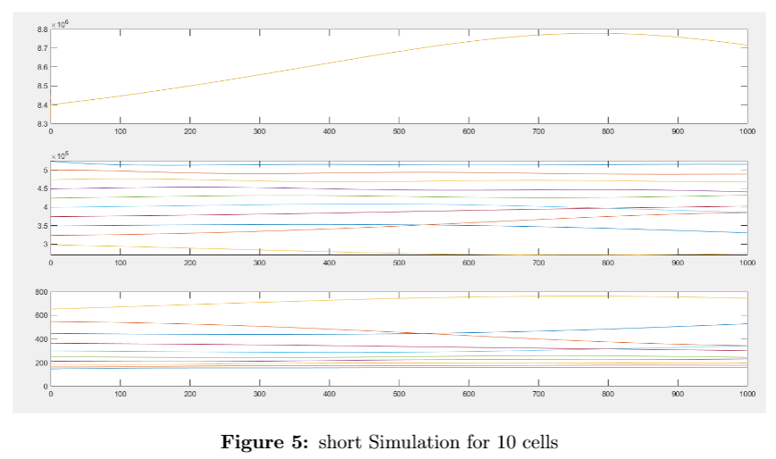
10 cells, beginning of transient (very small pressure drops)
p
h
d
or
rho

Slide 12
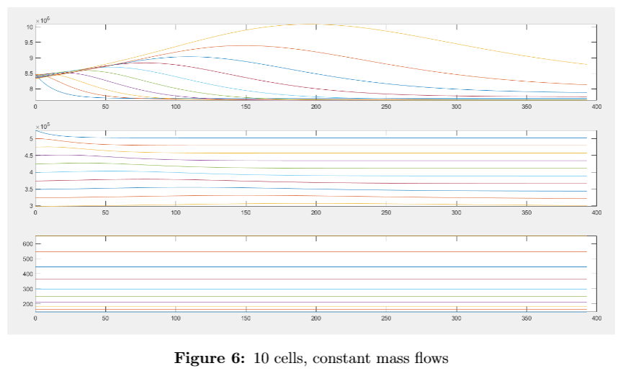
No resistance model, constant mass flow
p
h
d
or
rho

Slide 13
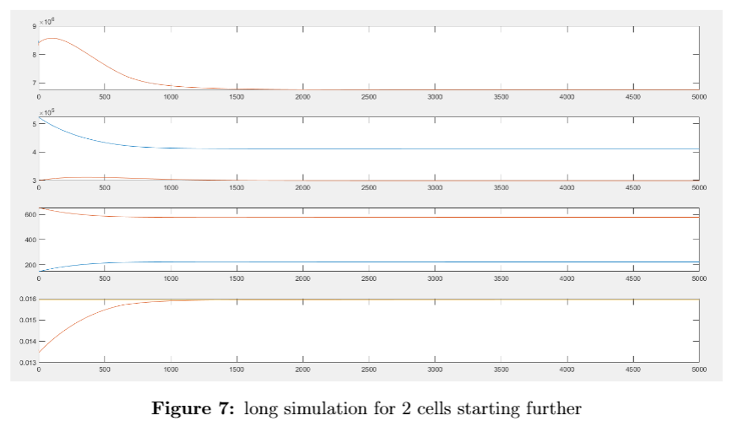
From now on resistances are considered again
Starting further from the steady state, 2 cells
p
h
d
or
rho
Dot(m)

Slide 14
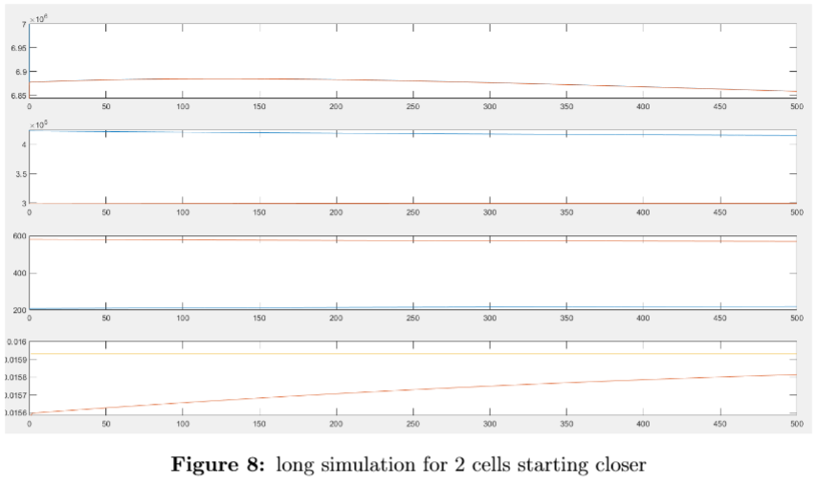
Starting closer to the steady state (the simulation is much quicker)
p
h
d
or
rho
Dot(m)

Slide 15
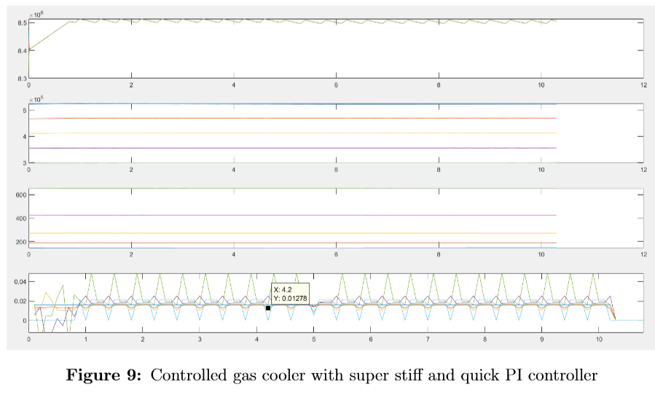
Controlled pressure, by adding outlet valve (timestep is 0.1 sec, discrete PI controller with same sampling and ZOH (zero order hold) time )
p
h
d
or
rho
Dot(m)

Slide 16
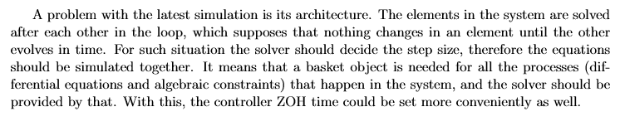
Controlled pressure, by adding outlet valve (timestep is 0.1 sec, discrete PI controller with same sampling and ZOH (zero order hold) time )
p
h
d
or
rho
Dot(m)

Slide 17
Close future
Simulating (solving) the system objects together (now they are frozen, until the others are calculated)
Giving time constant to actuator, and setting a rational sample time
Closing the loop
Possible problem: loop of algebraic equations, which can be solved by Dymola DAE solvers, but not with the general matlab solvers

Slide 18
Thank you for your time and see you on Monday!

